Slide 1
IBM University Engagement Project Submission
“Exploring the Power of Agentic AI with IBM Granite and LangFlow”

Slide 2
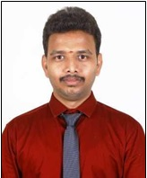
Project Tile – Agriculture Doctor Agent
Domain of Project – Agriculture
Faculty Name | Recent Passport Photo | Email ID | Mobile number [WhatsApp]
Mr. Dinesh Babu . K |  | dnesh.babu90@gmail.com | 7983583638

Slide 3
Problem Statement -
Problem Statement : Agri Doc Agent
Farmers often struggle to accurately identify crop diseases and receive timely, reliable guidance, leading to reduced yield and losses. Existing solutions lack personalization and real-time decision support. The proposed Agri Doctor Agentic AI system addresses this by providing intelligent diagnosis, treatment recommendations, and preventive advisory using a multi-agent architecture.
The Challenge
Agriculture is a critical sector, yet farmers frequently face significant challenges in identifying crop diseases, pest infestations, and nutrient deficiencies at early stages. Limited access to agricultural experts, lack of timely diagnosis, and reliance on unverified information often lead to incorrect treatments, reduced crop yield, and financial losses. Additionally, farmers struggle to obtain real-time, personalized, and actionable guidance for managing crop health and improving productivity.
The Objective
To develop an AI-powered Agri Doctor Agentic System that provides accurate diagnosis, treatment recommendations, and preventive advisory for crop-related issues. The system leverages a multi-agent architecture to simulate expert-level agricultural consultation and deliver reliable, real-time decision support to farmers. The solution should:
Multi-Agent System: A coordinated agentic architecture consisting of:
Diagnosis Agent – Identifies diseases, pests, or nutrient deficiencies based on symptoms
Treatment Agent – Recommends actionable treatment plans including fertilizers, pesticides, and dosages
Advisory Agent – Provides preventive measures, best farming practices, and farmer-friendly guidance
Core Functionalities
Crop Disease Diagnosis : Analyze symptoms and identify the most probable issue with confidence level
Personalized Treatment Recommendations : Suggest precise and practical solutions tailored to the crop and condition
Preventive Advisory & Best Practices: Provide guidance to avoid recurrence and improve crop health
Real-Time Decision Support: Deliver quick and reliable responses to farmers’ queries
Structured and Explainable Output : Ensure transparency with reasoning and confidence levels

Slide 4
Technology Used
Tech Stack (Mandatory)
Use any one of the following approaches:
LangFlow + IBM watsonx.ai + Granite Models
I used LangFlow + IBM watsonx.ai + Granite Models

Slide 5
Proposed Solution -
Proposed Solution: AI-Powered Agriculture Doctor Agent
The proposed solution is a multi-agent AI-powered Agri Doctor system built using Langflow, IBM watsonx.ai, and Granite models to provide personalized, real-time crop diagnosis and agricultural advisory. The system addresses challenges in early disease detection, accurate treatment, and preventive farming practices. At its core, the solution utilizes a Retrieval-Augmented Generation (RAG) pipeline to fetch relevant agricultural knowledge (crop diseases, pests, nutrient deficiencies, treatments) from trusted sources. This data is processed using Granite models to generate accurate, explainable, and actionable insights. The system consists of three key agents:
Diagnosis Agent: Analyzes crop symptoms provided by the user, Identifies diseases, pests, or nutrient deficiencies and Provides structured output with confidence level and reasoning.
Treatment Recommendation Agent : Suggests actionable treatment plans, Recommends fertilizers, pesticides, or corrective measures and Includes dosage and application methods.
Advisory Agent : Provides preventive measures and best farming practices, Offers farmer-friendly guidance for long-term crop health and Suggests sustainable and efficient agricultural techniques.
The solution that presents crop diagnosis results, treatment recommendations, and preventive advisories in a structured and visual format. It allows users to track crop health trends, monitor disease occurrences, and evaluate the effectiveness of applied interventions, thereby supporting data-driven and informed agricultural decision-making.
Langflow is utilized to orchestrate the multi-agent workflow, enabling seamless interaction between the Diagnosis, Treatment, and Advisory agents.
IBM watsonx.ai provides a scalable and secure platform for model deployment, embeddings, and AI governance. Granite models power the system’s core intelligence, including symptom analysis, reasoning, and generation of accurate, personalized agricultural recommendations.
Overall, this solution delivers an end-to-end intelligent agriculture assistant that empowers farmers with accurate crop diagnosis, personalized treatment recommendations, and preventive advisory. By providing real-time insights and actionable guidance, the system enhances crop productivity, reduces losses, and promotes sustainable and informed farming practices.

Slide 6
Langflow component Used -
1) Chat Input – Interface where users enter their queries, preferences, or crops, plants and tree details (text/voice/image).
2) IBM watsonx AI Agent - Processes user input using Granite models to generate personalized nutrition insights and recommendations.
3) Name of IBM Granite model - Granite-4.0-8B-Instruct → Fast, efficient for real-time diet recommendations
4) Chat output -Displays AI-generated responses such as providing real-time insights and actionable guidance, the system enhances crop productivity, reduces losses, and promotes sustainable and informed farming practices.
5) File component - Stores and retrieves agricultural data, including farmer inputs (crop type, symptoms), diagnosis records, treatment history, and crop-related datasets for analysis and continuous monitoring.

Slide 7
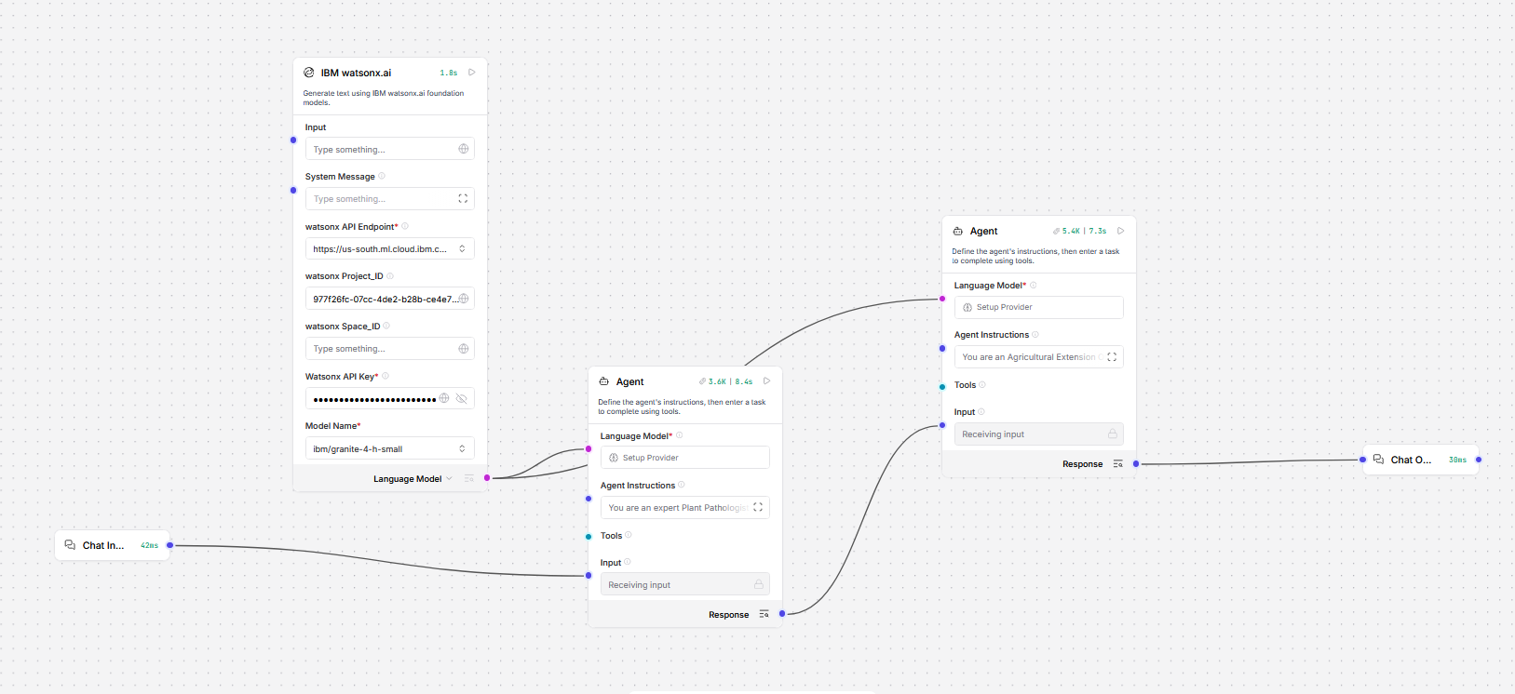
Langflow workflow -

Slide 8

Architecture blueprint

Slide 9

Role of Agentic AI in the solution
Role of Agentic AI in Agentic AI in Agri Doctor Agent
Agentic AI enables the Agri Doctor system to function as an intelligent, autonomous agricultural assistant rather than a simple query-based chatbot. By leveraging IBM watsonx.ai and Granite models, the system coordinates multiple specialized agents to deliver accurate crop diagnosis and personalized farming advisory. Each agent performs a dedicated role—such as analyzing crop symptoms (Diagnosis Agent), generating treatment plans (Treatment Agent), and providing preventive guidance (Advisory Agent)—while working collaboratively. This multi-agent architecture ensures efficient task execution, improved accuracy, and structured outputs. Agentic AI also introduces context awareness, allowing the system to consider factors such as crop type, soil conditions, climate, and farming practices to generate tailored recommendations. It supports real-time adaptation, continuously refining its suggestions based on new inputs like changing symptoms or environmental conditions. Additionally, agents communicate and pass structured outputs between each other, enabling better decision-making and more reliable outcomes. Overall, Agentic AI transforms the system into a proactive, intelligent, and goal-driven agricultural assistant, empowering farmers with expert-level insights, improving crop health, increasing productivity, and promoting sustainable farming practices.

Slide 10
Technology Used
Langflow platform -Used for designing and orchestrating the multi-agent workflow visually, enabling seamless coordination between the Diagnosis, Treatment, and Advisory agents.
IBM Grainte model - for eg – ibm-granite-3-2-8b – Utilized for natural language understanding, reasoning, and personalized response generation, allowing accurate crop diagnosis and intelligent agricultural recommendations.
IBM Cloud – Provides a secure, scalable, and reliable infrastructure to build, deploy, and manage the Agri Doctor system efficiently.
RAG– Ensures the system first retrieves relevant agricultural data (crop diseases, treatments, best practices) and then generates context-aware, accurate responses, improving reliability and trust.
IBM Watsonx.ai - Used for model deployment, embeddings, and AI governance, ensuring efficient performance, scalability, and responsible AI usage.
Vector Database (FAISS/Chroma) – Stores and retrieves agricultural knowledge data (disease information, treatment guidelines, crop advisory) to support RAG-based intelligent decision-making.

Slide 11
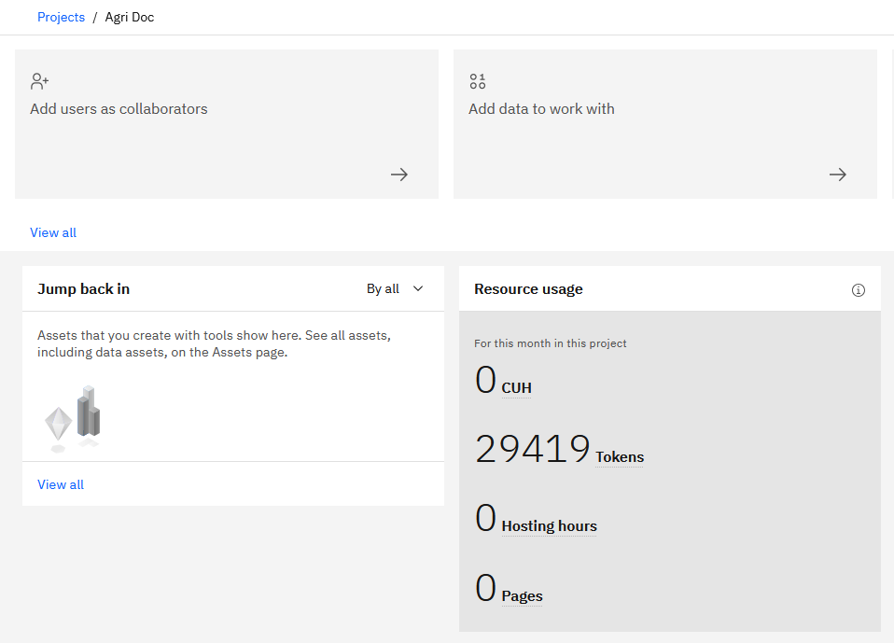
Token Usage
29,419 token are used

Slide 12
Novelty and Uniqueness
The proposed Agri Doctor Agent stands out by integrating Agentic AI, Retrieval-Augmented Generation (RAG), and personalized agricultural advisory into a unified intelligent system.
Multi-Agent Intelligence – Instead of a single chatbot, multiple specialized agents (Diagnosis, Treatment, Advisory) collaborate to deliver accurate, structured, and context-aware crop recommendations.
RAG-Based Accuracy – Combines real-time agricultural data retrieval with AI-generated responses, reducing misinformation and ensuring reliable and evidence-based crop advisory.
Hyper-Personalization – Provides tailored recommendations based on crop type, soil conditions, climate, and farming practices, ensuring relevance to individual farming scenarios.
Real-Time Feedback Loop – Continuously updates recommendations based on new symptoms, environmental changes, and farmer inputs, enabling dynamic and responsive decision support.
Multi-Modal Input – Supports text, voice, and image-based inputs (e.g., crop images for disease detection), enhancing usability and accessibility for farmers.
Preventive Healthcare Focus – Goes beyond diagnosis by offering preventive measures, best practices, and sustainable farming techniques to avoid future crop issues.
Scalable & Enterprise-Ready – Built on IBM watsonx.ai with Granite models, ensuring scalability, reliability, security, and AI governance for real-world deployment.
This makes the solution a smart, adaptive, and proactive digital agriculture assistant, rather than just a static crop advisory tool—empowering farmers with expert-level insights for improved productivity and sustainable farming.

Slide 13
Git Hub Link
https://github.com/dneshbabu90/Agri-DOC-Agentic-AI.git
·
·
·

Slide 14
Future Scope
1. Image-Based Disease Detection
The system can be enhanced by integrating computer vision techniques for image-based crop disease detection. Farmers will be able to upload images of affected plants for instant analysis. This will improve diagnostic accuracy compared to text-based symptom descriptions. It reduces dependency on manual input and supports faster decision-making. The feature can be extended using deep learning models trained on agricultural datasets. Overall, it will make the system more user-friendly and efficient for real-world usage.
2. Weather-Based Smart Advisory
The system can be extended by integrating real-time weather data for smarter recommendations. It can analyze factors like rainfall, temperature, and humidity. Based on weather conditions, the system can suggest irrigation, fertilization, and pest control measures. This helps farmers take preventive actions before problems occur. It improves crop planning and reduces risks due to climate variability. Ultimately, it enables more precise and sustainable farming practices.
·
·
·

Slide 15


